Slide 1
HF Infrastructure Architecture Framework

Slide 2
Key Points
What is an Architecture Framework
HF Infrastructure Architecture Method (SAABR)
SAABR Architecture Phases
SAABR Architecture Phases Explained
Requirements Management
Physical Design Template
Benefits of an Architecture Framework
What Next?

Slide 3
What is an Architecture Framework?
Classic Definition: A set of tools, methods, patterns, and practices to help build different architectures. Best understood what it does for us and how do we use it.
Notes:
Classic Definition: A set of tools, methods, and practices to help build different architectures
Best understood what it does for us and how do we use it?

Slide 4
What is an Architecture Framework?
Architecture Practice delivers prescriptive architectures and artifacts
Requirements are gathered and then sanitized to deliver final state architecture
An architecture includes various building blocks like, servers, applications, networks, security components, non-functional requirements like availability, scalability, recoverability, and patterns etc.
An Architecture Framework guides how these building blocks are build, retained and evolve

Slide 5
What is an Architecture Framework?
An Architecture Development Method is the main component of an Architecture Framework which provides mechanisms to build an architecture

Slide 6
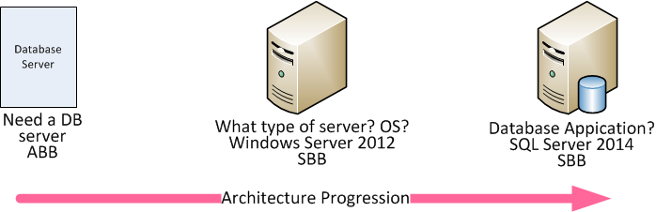
Architecture Building Blocks
Two Types:
Architecture Building Blocks - ABB
Solution Building Blocks - SBB
Notes:
Type of server? x86, RISC/ISA?

Slide 7

An organization needs an organization specific Architecture Framework & Architecture Development Method to guide its architecture

Slide 8
healthfirst Infrastructure Architecture Development Method (Proposed)
HF Infrastructure Architecture Development Method is a cycle of iterative processes which goes through four phases with an agile build phase. All phases are validated throughout the cycle
Notes:
TOGAF ADM covers the full gamut of Enterprise Architecture. Phase C, Information Systems Architecture, and Phase D, Technology Architecture has been used to derive healthfirst Infrastructure Development Methods

Slide 9
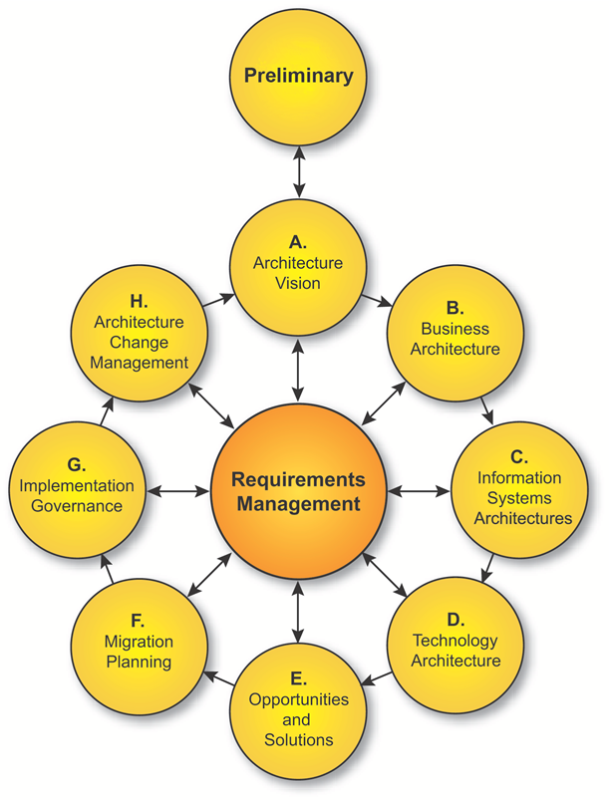
TOGAF ADM
HF Infrastructure Architecture Development Method is derived from TOGAF which is one of the major architecture frameworks. Architecture Development Method (ADM) is the main component of TOGAF which provides mechanisms to build an architecture
Notes:
9 phases

Slide 10
healthfirst Infrastructure Architecture Development Method (Proposed)
Comprised of Four phases
Four phases are given the moniker SAABR (Read as Saber)
SAABR stands for:
S – Statement
A – Architecture
AB – Agile Build
R – Rollout
Notes:
Phases are discussed from slides 15 onwards

Slide 11
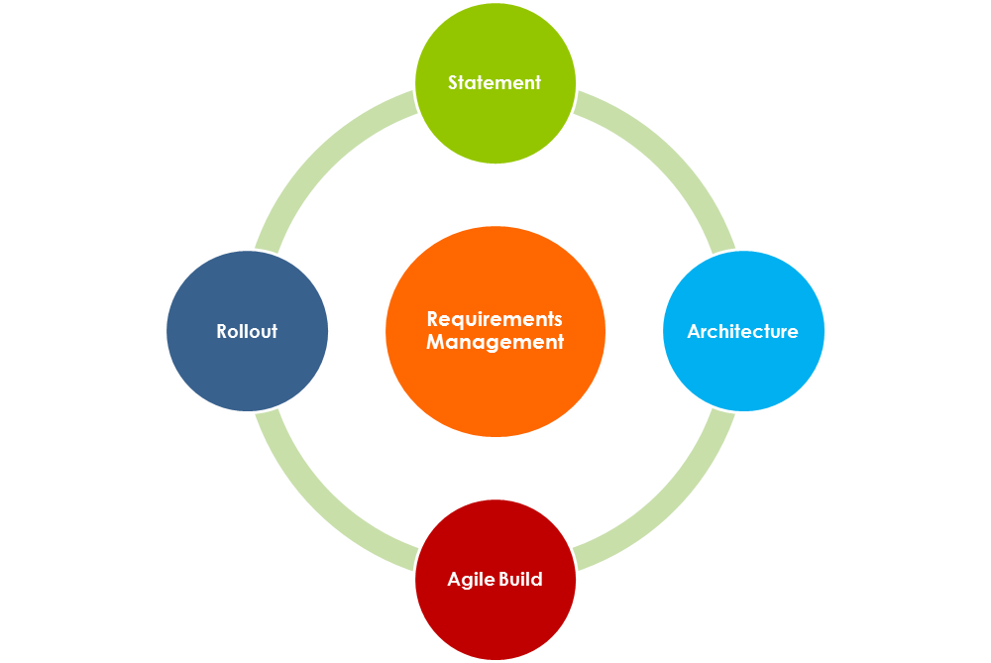
SAABR Architecture Cycle
Notes:
Requirements Management is not a phase. it is discussed in a separate slide

Slide 12
SAABR Architecture Phases
Statement
High level project definition and requirements
Architecture
Gather requirements and build an Architecture design
Agile Build
Produce compute and storage layout and deliver physical or virtual capacity. Work on other requirements in parallel while provisioning
Roll out
Roll out the environment to end user
Notes:
S – Statement, A – Architecture, AB – Agile Build, R – Roll out

Slide 13
SAABR Architecture Phases
What SAABR is all about?
What are the objectives of each SAABR phase?
What are the key inputs and outputs produced during each phase?
Notes:
What we do during each phase and how each phase feeds to following phase

Slide 14
Objective of SAABR Phases
SAABR cycle produces an end state architecture using an iterative four phase process. Requirements are discovered and consumed during phases. SAABR is applied iteratively throughout the entire process, between phases, and within them.
Notes:
Core Objective: Discover requirements, sanitize, agree on requirements, consume requirements. Each phase is an iteration of a different Requirements Management phase
Requirements cycle:
Discovery
Sanitization
Agreement
Consumption

Slide 15
Requirements gathering during SAABR Phases
Many requirements are captured during an Infrastructure Architecture cycle. SAABR cycle recognizes these requirements:
Compute requirements
Storage requirements (Size, IOPS, replication etc.)
Networking requirements
Software requirements
Database server requirements

Slide 16
Requirements gathering during SAABR Phases (Continued)
Security Requirements (SLS/TLS, encryption at rest etc.)
Regulatory requirements (Audit etc.)
Backup requirements (Retention policy, off site tape, archiving)
Monitoring Requirements
Notes:
e.g. security requirements are driven by regulatory concerns

Slide 17
SAABR Phases
Next few slides explain each SAABR phase

Slide 18
Statement Phase
Project sponsor will open a problem statement (in ServiceNow?) and provide a brief description of the project, high level requirements, and some specific information
Notes:
Need a repository system or a Request System which will track progress and changes, keep all the artifacts, and to upload and download required documents

Slide 19
Different fields in ServiceNow Demand Management module could be used to provide following information for the Statement Phase
Notes:
Recovery Time Objective, Recovery Point Objective, Recovery Capacity Objective

Slide 20

Demand Management Request Form (Statement Phase)
Request Type:
New
Incremental
Refresh
Application owner
Application name
Application ID
Application type?
Internal application?
External client facing?
Internal corporate application?
Application tier
Availability requirements – RTO, RPO, RCO
Notes:
Refresh = EOL H/W, S/W, OS

Slide 21
Architecture Phase
This is the architecture development phase. This phase will consume inputs from the S-Statement phase. Key outputs from this phase will be:
Current state
Gather and agree on requirements (Discovery)
Final state, which could include a physical design:
Compute capacity
Physical or virtual
Storage capacity
LB
FW
Software to be installed

Slide 22
Architecture Phase (Continued)
Determination that architecture is IT-aligned or not!
If architecture is not IT-aligned, should a roadmap be required to achieve IT alignment?
(section IT Architecture principles TBD)!

Slide 23
Agile Build Phase
First two phase of the SAABR architecture are traditional waterfall method but next phase is an “Agile Build” phase where different “Build Design Packages” BDP’s will be delivered in parallel.
Notes:
BDP or Build Design Package is a similar concept like ITIL SDP – Service Design Package. TOGAF has work packages which is to divide deployment work in smaller deployment activities

Slide 24
Agile Build Phase Explained:
This phase will consume outputs form the Architecture phase to develop various “Build Design Packages” or BDP’s
A BDP is a package that is comprised of several build and deployment activities to comprise a Continuous Build Stream

Slide 25
Agile Build Phase with Continuous Build Stream
Agile build means these BDP’s will be delivered in parallel. A BDP will be delivered while another is in progress making a Continuous Build Stream in which BDP’s are consumed and worked upon by different teams while other BDP’s are being produced.
Notes:
BDP or Build Design Package is a similar concept like ITIL SDP – Service Design Package. TOGAF has work packages which is to divide deployment work in smaller deployment activities. Composition of BDP’s and parallel implementation I took how used to do at ----

Slide 26
BDP1
BDP 2
BDP 3
Agile Build Phase will produce several Build Design Packages (BDP’s) in parallel

Slide 27
Continuous Build Stream Agile Build Phase
Continuous Build Stream
BDP 1
BDP 2
BDP 3
Notes:
Build Requirements will be gathered and packaged
Derived from TOGAF work packages and ITIL Service Design Packages

Slide 28
Continuous Build Stream Agile Build Phase
These Build Design Packages are defined:
BDP 1
Compute size, DC location, server naming
Storage Layout
BDP 2
User and service accounts, permissions
Software and Database Requirements
Notes:
Work packages and implementation is
Composition of parallel BDP’s have learned at ----
Need consistent server naming convention
Industry best practices

Slide 29
Build Design Packages Continuous Build Stream
BDP 3
DNS /URL Requirement
SSL/TLS
LLB
GLB
FW
Backups
Monitoring (application, URL or standard server monitoring like SCOM)

Slide 30
Rollout
Architecture is now available for end user use. This phase may include UAT and user simulation.

Slide 31
Requirements Management
Requirements Management applies to all phases of SAABR cycle. Requirements Management is a dynamic process identifying requirements throughout SAABR cycle and stores them in a repository system (SNOW? SharePoint?, Other?). These requirements evolve from ABB to SBB and are produced and consumed through out SAABR cycle.

Slide 32
Physical Design Template
It is a diagrammatical representation of the physical design of an infrastructure architecture depicting physical artifacts like servers, storage, networking components, and software components
A Visio design template will be presented

Slide 33
Benefits of an Infrastructure Framework
Efficiency
Visibility
Agility
Controllability
Notes:
Reference TOGAF v 9.0

Slide 34

Efficiency
Technology and processes are standardized
Stream lined buying because of information availability
Easier upgrade and exchange of system components
Repeatable artifacts
Notes:
How efficiency is achieved

Slide 35

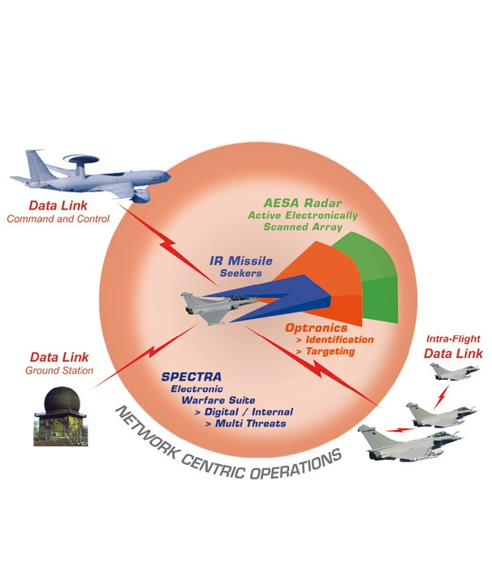
Visibility
Situational awareness, able to see blind spots, large radar crossection
Notes:
What is Visibility
Benefits of Visibility

Slide 36
Visibility
IT Leadership know what’s going on!
Stake holders; IT Leadership and business owners have a better visibility of technology landscape → Helps in decision making

Slide 37
Visibility
Business and capabilities shared across organization because of Infrastructure knowledge
Lower software development, support, and maintenance costs because knowledge of existing systems helps in reusability and to avoid building duplicate systems

Slide 38
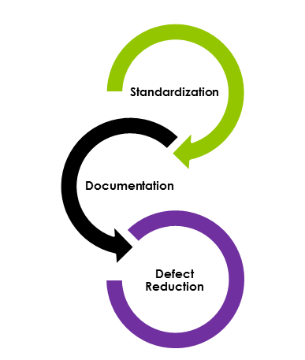
Agility
Standardization reduces defects
Availability of a catalogue of standard organization-wide product portfolio like physical bundles, virtual shirt sizes, and COTS eliminate guess work
IT is able to respond rapidly

Slide 39

Controllability
Architecture cycle provides several toll gates to check what is going into the datacenter helping IT leadership to control spending

Slide 40
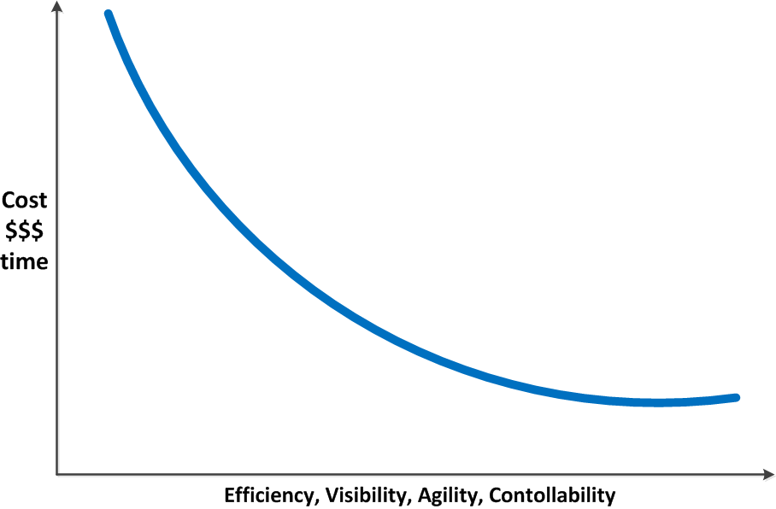
Benefits of an Infrastructure Framework
All of that help reduce cost and improve efficiencies across IT operations

Slide 41
What Next
Develop Infrastructure Architecture Principles
Virtualize where possible
Use of SAN storage (for physicals)
Tier-1 and Tier-2 applications should have a DR environment (Discuss)
Notes:
Virtualize where possible, otherwise ask for business justification. Get current, historical or expected performance data to validate compute requirements.
Need to properly size virtual or physical compute capacity.

Slide 42
What Next
Incorporate an exception process in certain situations
Incorporate a governance process to stop an architecture project if it does not meet business goals

